Slide 1
Localization
Advanced Android Development
Lesson 5

Slide 2

5.2 Locales
Modify an app for a user's locale

Slide 3
Contents
Overview of locale customization
Formatting date, time, and numbers
Formatting currencies
Retrieving and using the user-chosen locale
Adding resources for different locales

Slide 4
Overview
Using the user's chosen locale

Slide 5
Locale best practices
Convert date, time, number, and currency formats to the user's locale
Use class methods to convert—don't hardcode formats
Store data in format for the default locale and convert to user's locale as needed

Slide 6
Formatting dates and times

Slide 7
DateFormat class
Use DateFormat to apply format of user-chosen locale
DateFormat.getDateInstance() to get format for user's locale
DateFormat.format() to prepare a string for display
final Date myDate = new Date();
String myFormattedDate =
DateFormat.getDateInstance().format(myDate);
TextView dateView = (TextView) findViewById(R.id.date);
dateView.setText(myFormattedDate);

Slide 8
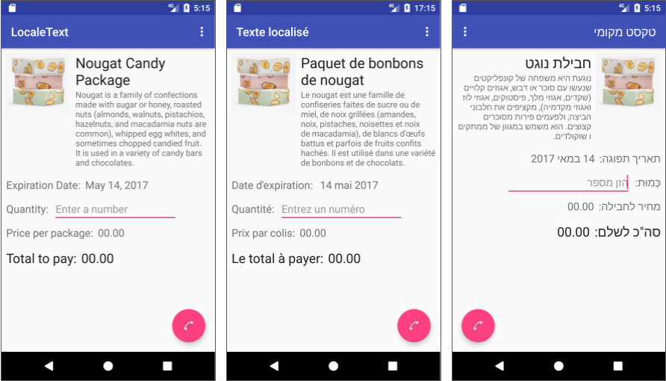
DateFormat example
Date format changes for each locale

Slide 9
DateFormat methods
getDateInstance(): Date format for user-chosen locale
getDateInstance(int style, Locale aLocale): Date format for Locale using supplied style
getTimeInstance(): Time format for user-chosen locale
getDateTimeInstance(): Combined date and time format for user-chosen locale

Slide 10
Formatting numbers

Slide 11
NumberFormat class
Use NumberFormat.getInstance() to format a number for any locale
Android provides Locale constants for many countries and locales
NumberFormat numberFormat =
NumberFormat.getInstance(Locale.FRANCE);

Slide 12
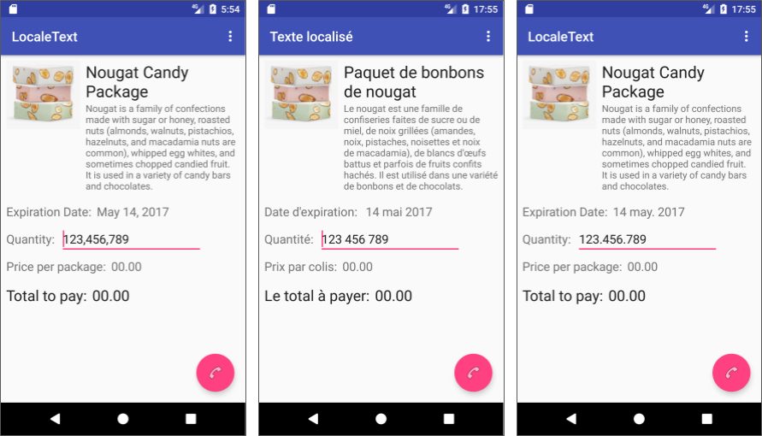
NumberFormat example
Number format changes for each locale

Slide 13
NumberFormat methods
getIntegerInstance(): Returns an integer format for current locale
getPercentInstance(): Returns a percentage format for current locale
getCurrencyInstance(): Returns a currency format for current locale

Slide 14
Parse a string into a number
Use NumberFormat.parse() to parse a string and intValue() to return an integer:
myQuantity = numberFormat.parse
(qtyInput.getText().toString()).intValue();

Slide 15
Formatting currency

Slide 16
Use NumberFormat for currency
Use NumberFormat for currency formats
NumberFormat.getCurrencyInstance() gets the currency format for current locale
NumberFormat.format() to prepare a string for display
NumberFormat currencyFormat = NumberFormat.getCurrencyInstance();
String myFormattedPrice = currencyFormat.format(myPrice);
TextView localePrice = (TextView) findViewById(R.id.price);
localePrice.setText(myFormattedPrice);

Slide 17
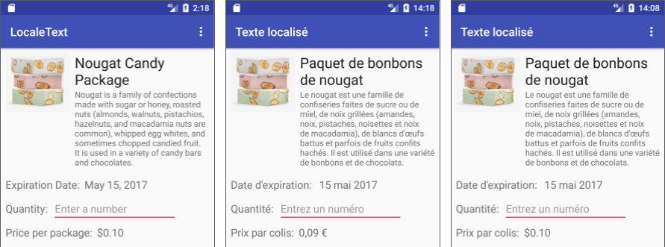
NumberFormat currency example
Number format for currency changes for each locale

Slide 18
Retrieving and using the locale

Slide 19
Get the country/region code
Use Locale.getDefault() to get the current locale
Use Locale.getDefault().getCountry() to get country/region code for current locale
String deviceLocale = Locale.getDefault().getCountry();
if (deviceLocale.equals("FR") || deviceLocale.equals("IL")) {
// If locale is either France or Israel...

Slide 20
Use a Locale constant
Locale constants to create Locale objects
Locale.US for United States
Locale.UK for United Kingdom
currencyFormat =
NumberFormat.getCurrencyInstance(Locale.US);

Slide 21
Adding resources for locales

Slide 22
Resource directories in project
values: Text, color, dimensions, and styles for the default language/locale
drawable: Drawables for the default language/locale
layout: Layouts for the default language/locale

Slide 23
Manage resource directories
Default resource directories provided in Android Studio project
Use Android Studio to add a resource directory for each supported language/locale
Android selects the resource directory that best matches user's chosen language/locale

Slide 24
Default values are important
If user selects a language/locale not supported by your app:
Android chooses default resources
Make sure app includes full set of default resources

Slide 25
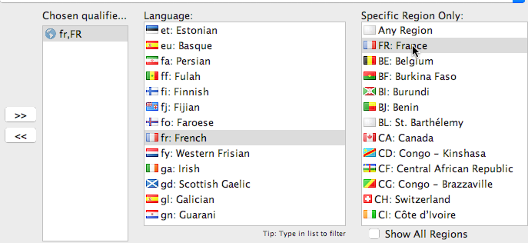
Add resource directories
Right-click res and select New > Android Resource Directory
Choose Resource type (values, drawable, etc.)
Select Locale and click >> to select a language and locale.

Slide 26
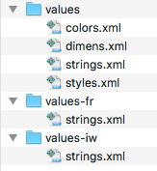
Added values directories in the system
A values directory for each language/locale
values-fr (French in France)
values-iw (Hebrew in Israel)
Text translations in each strings.xml file

Slide 27
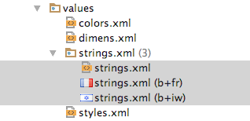
Added values in Android Studio
The values directory in Project: Android view
Translated text is organized under strings.xml

Slide 28
Name format for resource directories
<resource>-<language>[-r<country>]
<resource>: Resource type (values, drawable, etc.)
<language>: Language (en for English, fr for French)
<country>: Optional code (US for U.S., FR for France)
Examples:
values-fr-rFR: Values for French in France
drawable-fr-rFR: Drawables for French in France

Slide 29
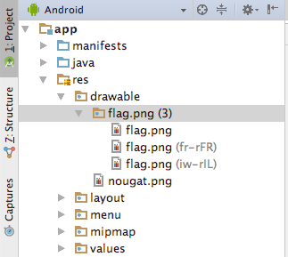
Drawables for different languages
The drawable directory in Project: Android view in Android Studio
Image files for different locales/languages within drawable

Slide 30
What's next?
Concept chapter: 5.2 Locales
Practical: 5.2 Using the locale to format information

Slide 31
END

